Slide 1

Conditional Random Fields
By Ali Ballout

Slide 2
INTRODUCTION TO CRFS

Slide 3

Objectives:
Define CRFs and explain their purpose
Discuss common applications of CRFs in NLP
Compare CRFs to other machine learning algorithms for sequence labeling
Outline the basic architecture of a CRF
By the end of this lesson, you will have a solid understanding of what CRFs are, how they are used, and why they are important in NLP.

Slide 4
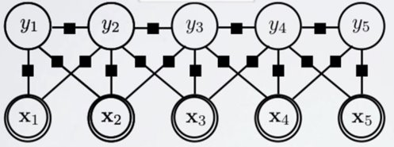
What are CRFs?
Conditional Random Fields (CRFs) are a type of probabilistic graphical models that are commonly used for sequence labeling tasks in NLP.
CRFs model the relationship between a set of input features and the output label sequence. They are designed to capture the dependencies between the output labels, which allows them to produce more accurate results compared to other machine learning algorithms for sequence labeling.
Notes:
-CRFs are a powerful tool in NLP for modeling the dependencies between input features and output labels in sequence labeling tasks.
-Probabilistic graphical models (PGMs) are a type of mathematical model used in machine learning and artificial intelligence to represent complex relationships between variables.
-They consist of two main components:
--a graphical structure that represents the relationships between variables and
--a probabilistic model that specifies the probability distribution of the variables given their relationships.
-In PGMs, variables are represented as nodes in a graph and the relationships between them are represented as edges.
-The graph structure allows us to visualize and reason about the relationships between variables, while the probabilistic model allows us to perform inference, make predictions, and estimate the uncertainty of our predictions.
There are two main types of PGMs: Bayesian networks and Markov random fields. Bayesian networks represent causal relationships between variables, where an influence of one variable on another is explicitly specified. Markov random fields, on the other hand, represent more general, non-causal relationships between variables and are often used for modeling patterns and dependencies in high-dimensional data.
PGMs have numerous applications in a wide range of fields, including computer vision, natural language processing, and bioinformatics, among others. They are especially useful for modeling complex, high-dimensional problems where traditional statistical methods may not be sufficient.

Slide 5
The Architecture of a CRF
Input Layer: The input layer consists of a set of features that describe the input sequence. These features can include words, POS tags, etc.
Middle Layer: This layer models the dependencies between the output labels. It uses the input features to compute the probability distribution over the output labels.
Output Layer: The output layer produces the final output label sequence by selecting the most probable label sequence based on the information from the hidden layer.
Notes:
A CRF has a simple and straightforward architecture, consisting of three main components: the input layer, the middlelayer, and the output layer.

Slide 6
CRFs in NLP
Named Entity Recognition (NER): In NER, the goal is to identify and categorize named entities, such as people, places, organizations, and more, in text. CRFs are well-suited for this task due to their ability to model the dependencies between entities.
Part-of-Speech Tagging (POS): In POS, the goal is to identify the part of speech for each word in a sentence. CRFs are used for this task because they can model the dependencies between words and the context in which they are used.
Shallow Parsing: Shallow Parsing, also known as Chunking, involves dividing a sentence into chunks, or phrases, and labeling them. CRFs are used for this task because they can model the dependencies between chunks and the context in which they are used.
Notes:
CRFs are widely used in NLP for various sequence labeling tasks due to their ability to model dependencies between elements in a sequence

Slide 7
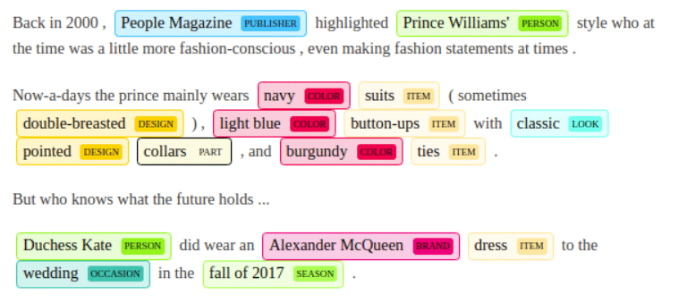

Slide 8
Comparison

Slide 9
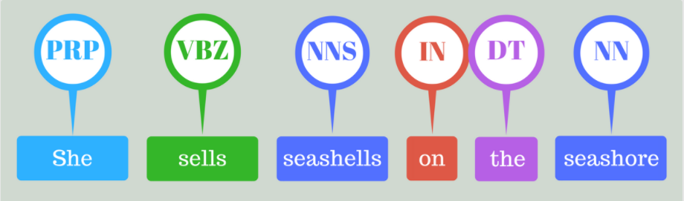
Sequence Labeling
Sequence labeling is a common task in NLP, where the goal is to assign labels to elements in a sequence, such as words in a sentence.
Sequence labeling is an important task in NLP as it is the foundation for several other NLP tasks we mentioned before, including Named Entity Recognition, Part-of-Speech Tagging, and Shallow Parsing.

Slide 10
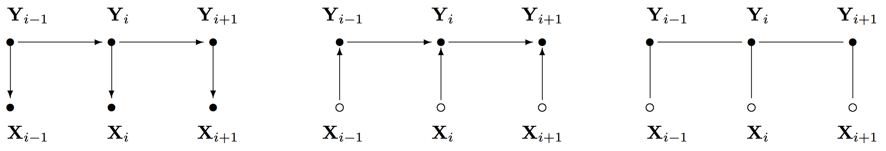
CRFs vs Other ML Algorithms
There are several machine learning algorithms for sequence labeling:
Hidden Markov Models (HMMs)
Maximum Entropy Markov Models (MEMMs)
Conditional Random Fields (CRFs)
HMMs
MEMMs
CRFs

Slide 11
Hidden Markov Models (HMMs)
Overview: Hidden Markov Models (HMMs) are a popular machine learning algorithm for sequence labeling. HMMs model the dependencies between the hidden states, which are then used to predict the output labels.
Limitations: HMMs have limitations when it comes to modeling complex dependencies between elements in a sequence (parameter number).
Notes:
limitations:
Stationarity assumption: HMMs assume that the underlying probability distribution that generates the data does not change over time. This can lead to incorrect results if the underlying process changes over time.
Gaussian assumption: HMMs often assume that the observations are generated from a Gaussian distribution, which may not be appropriate for all types of data. This can lead to incorrect results if the observations are not Gaussian.
Limitations in modeling long-term dependencies: HMMs are designed to model short-term dependencies between observations, but they may not be suitable for modeling long-term dependencies, as the number of parameters required to model such dependencies grows quickly with the length of the sequence.
Sensitivity to initialization: The parameters of HMMs are estimated using an iterative optimization process, which can be sensitive to the initial values of the parameters. This means that different initializations can result in different final models, and it can be difficult to determine the optimal initialization.
Limited expressiveness: HMMs are a relatively simple model, and as a result, they may not be expressive enough to capture complex patterns and dependencies in the data.
https://www.youtube.com/watch?v=kqSzLo9fenk&ab_channel=Serrano.Academy

Slide 12
Maximum Entropy Markov Models (MEMMs)
Overview: Maximum Entropy Markov Models (MEMMs) are an extension of HMMs, which use the maximum entropy principle to model the dependencies between the elements in a sequence.
Limitations: While MEMMs perform better than HMMs in terms of modeling complex dependencies, they still have limitations when it comes to handling noisy or missing data.
Notes:
In HMMs, the probability distribution of the hidden states is modeled as a discrete probability distribution. The transition probabilities between the hidden states are estimated based on the training data, and these probabilities are used to generate predictions for new sequences.
In MEMMs, the probability distribution of the hidden states is modeled as a maximum entropy distribution. This means that the distribution is chosen to be as uniform as possible, subject to some constraints that are derived from the training data. The constraints reflect the observed relationships between the inputs and outputs in the training data, and they are used to estimate the parameters of the model.
--So, to put it simply, the main difference between HMMs and MEMMs is that HMMs use a fixed, discrete probability distribution to model the hidden states, while MEMMs use a more flexible, maximum entropy distribution that is based on the observed relationships in the training data.
The idea behind the maximum entropy principle is to reflect the fact that we often don't have enough information to make confident predictions about the future. In such cases, it's better to make predictions that are as uncertain as possible, rather than making overly confident predictions that may turn out to be wrong.
For example, imagine that you are trying to predict the weather for the next day. If you have no information about the current weather conditions, it would be reasonable to predict that the weather will be either sunny, cloudy, or rainy, with equal probabilities. This would reflect your uncertainty about the future weather.
On the other hand, if you have more information, such as the current temperature and humidity, you might be able to make a more confident prediction. For example, if it's hot and humid, you might predict that it will be sunny tomorrow with a high probability.
The maximum entropy principle can be applied to any situation where you want to make predictions based on limited information. By choosing a distribution that is as uniform as possible, subject to some constraints, you can reflect the uncertainty of your predictions in a mathematically rigorous way.
In essence, the maximum entropy principle is a way of encoding our prior beliefs about the relationships between inputs and outputs into a probabilistic model, and it is often used in machine learning and other fields to make predictions that are as uncertain as possible, given the information we have.
Computational Complexity: MEMMs can be computationally expensive to train and use, especially when dealing with large datasets or complex models. This can make them impractical for some applications where computational resources are limited.
Overfitting: Like many machine learning models, MEMMs can be prone to overfitting, which means that they can fit the training data too closely and perform poorly on new, unseen data. To mitigate this problem, techniques such as regularization or cross-validation can be used.
Limited Model Capacity: MEMMs can have limited model capacity, which means that they may not be able to capture complex relationships between inputs and outputs. In some cases, more complex models, such as deep learning networks, may be more appropriate.
Difficulty in Interpreting Results: Like many probabilistic models, MEMMs can be difficult to interpret, especially when dealing with large or complex models. This can make it challenging to understand why the model is making certain predictions and to identify sources of error.
Limited Availability of Training Data: MEMMs are designed to work with large amounts of training data, and they may not perform well with limited training data. In such cases, alternative models, such as Hidden Markov Models (HMMs), may be more appropriate.

Slide 13
Conditional Random Fields (CRFs)
Overview: Conditional Random Fields (CRFs) are a type of machine learning algorithm for sequence labeling that models the dependencies between the elements in a sequence, as well as the context in which they are used.
Advantages: CRFs offer several advantages over HMMs and MEMMs, including their ability to model complex dependencies, handle noisy or missing data effectively, and their flexibility in adapting to different types of sequence labeling tasks.
Notes:
https://www.youtube.com/watch?v=rI3DQS0P2fk&ab_channel=ritvikmath

Slide 14
Why use CRFs?
Modeling Dependencies: CRFs are designed to model the dependencies between elements in a sequence. This allows them to produce more accurate results compared to other algorithms that do not consider these dependencies, as well as the context in which they are used.
Flexibility: CRFs are flexible and can be easily adapted to different types of sequence labeling tasks by adjusting the input features and the model architecture.
A discriminative model, can use complex features X and is more efficient, BUT always needs complete features X => does not handle incomplete data very well.
Notes:
CRFs offer several advantages over other machine learning algorithms for sequence labeling tasks including their ability to model dependencies, flexibility, and robustness.
.

Slide 15
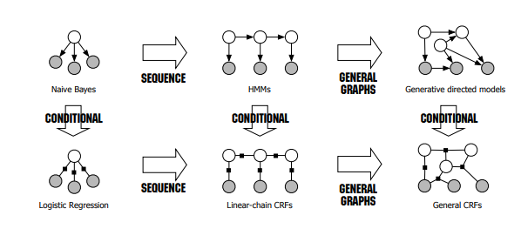

Slide 16
Mathematical Foundation of CRFs

Slide 17
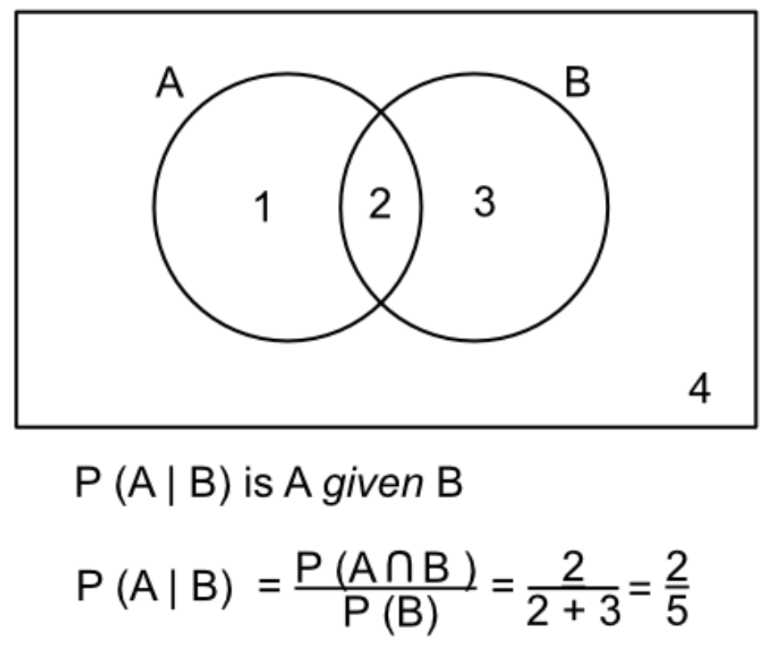
Definition of Conditional Probability
Conditional probability is a measure of the probability of an event, given that another event has occurred.
Definition: Let A and B be two events, then the conditional probability of event A, given that event B has occurred, is defined as P(A|B) = P(A and B) / P(B)

Slide 18
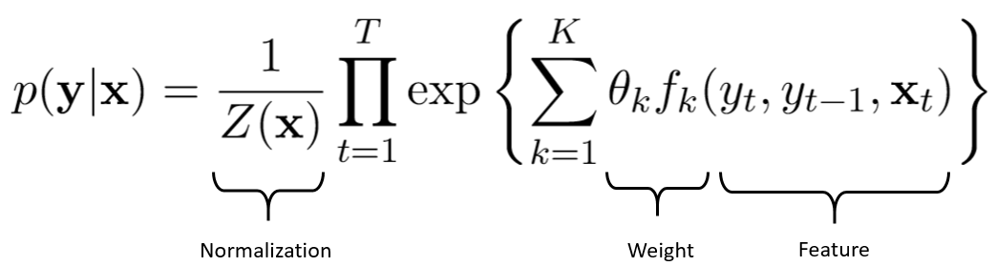
Formulation of the CRF Model
The CRF model is a probabilistic graphical model that models the dependencies between the elements in a sequence and the context in which they are used.
Definition: Let X be a sequence of n elements, Y be a set of m labels, and p(Y|X) be the conditional probability of the labels given the sequence, then the CRF model is defined as p(Y|X) = 1/Z(X) * exp{Σ w(i,j)f(i,j,X,Y)}, where Z(X) is a normalization term, w is a set of weights, and f(i,j,X,Y) is a set of feature functions.
Notes:
The mathematical formula for the conditional probability in a Conditional Random Field (CRF) model is given by:
P(Y|X) = 1/Z(X) * exp(Σ_i Σ_j w_i f_i(X,Y_i) f_j(X,Y_j))
where:
P(Y|X) is the conditional probability of the output Y given the input X
Z(X) is a normalization factor, which ensures that the sum of all possible outputs is 1
w_i is the weight of the i-th feature function
f_i(X,Y_i) is the i-th feature function, which calculates the contribution of the i-th feature to the probability of the output Y given the input X
Σ_i is the sum over all feature functions
Y_i is the i-th possible output
Σ_j is the sum over all possible outputs
Each element in the formula has a specific role:
P(Y|X) represents the final answer, the probability of the output Y given the input X
Z(X) is a normalization factor, which ensures that the sum of all possible outputs is 1
w_i is the weight of the i-th feature function, which represents the importance of the i-th feature in determining the probability of the output Y
f_i(X,Y_i) is the i-th feature function, which calculates the contribution of the i-th feature to the probability of the output Y given the input X
Σ_i is the sum over all feature functions, which represents the total contribution of all features to the probability of the output Y
Y_i is the i-th possible output, which represents one of the possible values that the output Y can take
Σ_j is the sum over all possible outputs, which represents the sum of the probabilities of all possible outputs, given the input X.

Slide 19





Slide 20
Random variable:
smokes or not

Slide 21
Suppose you know that and are friends! What does this tell you?

Slide 22
Suppose you know that and are friends! What does this tell you?
=> They might have similar smoking habits!

Slide 23
Suppose you know that and are friends! What does this tell you?
=> They might have similar smoking habits! Is this useful to model smoking behaviors?

Slide 24
Suppose you know that and are friends! What does this tell you?
=> They might have similar smoking habits! Is this useful to model smoking behaviors?
=> Call it a feature then!

Slide 25
Suppose you know that and are friends! What does this tell you?
=> They might have similar smoking habits! Is this useful to model smoking behaviors?
=> Call it a feature then!
=> Need a way to represent interactions!

Slide 26
Suppose you know that and are friends! What does this tell you?
=> They might have similar smoking habits! Is this useful to model smoking behaviors?
=> Call it a feature then!
=> Need a way to represent interactions!
=> Use Graphs!

Slide 27
Suppose you know that and are friends! What does this tell you?
=> They might have similar smoking habits! Is this useful to model smoking behaviors?
=> Call it a feature then!
=> Need a way to represent interactions!
=> Use Graphs!

Slide 28
Suppose you know that and are friends! What does this tell you?
=> They might have similar smoking habits! Is this useful to model smoking behaviors?
=> Call it a feature then!
=> Need a way to represent interactions!
=> Use Graphs!
What’s the problem?

Slide 29
Suppose you know that and are friends! What does this tell you?
=> They might have similar smoking habits! Is this useful to model smoking behaviors?
=> Call it a feature then!
=> Need a way to represent interactions!
=> Use Graphs!
What’s the problem?
Every variable depends on every other variable!

Slide 30
Suppose you know that and are friends! What does this tell you?
=> They might have similar smoking habits! Is this useful to model smoking behaviors?
=> Call it a feature then!
=> Need a way to represent interactions!
=> Use Graphs!
=> Need a way to represent independence!
What’s the problem?
Every variable depends on every other variable!

Slide 31
Suppose you know that and are friends! What does this tell you?
=> They might have similar smoking habits! Is this useful to model smoking behaviors?
=> Call it a feature then!
=> Need a way to represent interactions!
=> Use Graphs!
=> Need a way to represent independence!

Slide 32
Suppose you know that and are friends! What does this tell you?
=> They might have similar smoking habits! Is this useful to model smoking behaviors?
=> Call it a feature then!
=> Need a way to represent interactions!
=> Use Graphs!
=> Need a way to represent independence!
Does this mean and
are totally independent?
that

Slide 33
Suppose you know that and are friends! What does this tell you?
=> They might have similar smoking habits! Is this useful to model smoking behaviors?
=> Call it a feature then!
=> Need a way to represent interactions!
=> Use Graphs!
=> Need a way to represent independence!
Does this mean and
are totally independent?
that

Slide 34
Suppose you know that and are friends! What does this tell you?
=> They might have similar smoking habits! Is this useful to model smoking behaviors?
=> Call it a feature then!
=> Need a way to represent interactions!
=> Use Graphs!
=> Need a way to represent independence!
Does this mean and
are totally independent?
that
Is independent from
only when we know and

Slide 35
Suppose you know that and are friends! What does this tell you?
=> They might have similar smoking habits! Is this useful to model smoking behaviors?
=> Call it a feature then!
=> Need a way to represent interactions!
=> Use Graphs!
=> Need a way to represent independence!
Does this mean and
are totally independent?
that
Is independent from
only when we know and
Called the Markovian Blanket

Slide 37
Ψ₁
Ψ₄
Ψ₂
Ψ₃

Slide 38
Call it a FACTOR
Ψ₁
Ψ₄
Ψ₂
Ψ₃

Slide 39
Call it a FACTOR
Ψ₁
Ψ₄
Compatibility between and
Ψ₂
Ψ₃

Slide 40
Call it a FACTOR
Ψ₁
Ψ₄
Compatibility between and
Ψ₂
Ψ₃
ASSUMPTION: A given state of variables (we say a possible world) is more likely iff the overall compatibility is higher

Slide 41
How to deﬁne compatibility in our case?
Ψ₁
Ψ₄
Ψ₂
Ψ₃

Slide 42
How to deﬁne compatibility in our case?
Ψ₁( , ) =
1 if and are friends and both smoke or both don’t smoke
0.5 if and are are not friends
0 if and are friends and don’t have same smoking habits
Ψ₁
Ψ₄
Ψ₂
Ψ₃

Slide 43
Ψ₁( , ) =
1 if and
are friends and both smoke or both don’t smoke
0.5 if | and | are are not friends
0 if | and | are friends and don’t have same smoking habits
Ψ₁
Ψ₄
Suppose that:
Is friends with . is friends with
What world is most likely between the following two?:
Ψ₂
Ψ₃
1. Smokes{ | , | } and Does not Smoke { | , | }
2. Smokes{ | , | } and Does not Smoke { | , | }

Slide 44
Ψ₁( , ) =
1 if and
are friends and both smoke or both don’t smoke
0.5 if | and | are are not friends
0 if | and | are friends and don’t have same smoking habits
Ψ₁
Ψ₄
Suppose that:
Is friends with . is friends with
What world is most likely between the following two?:
Ψ₂
Ψ₃
1. Smokes{ | , | } and Does not Smoke { | , | }
2. Smokes{ | , | } and Does not Smoke { | , | }

Slide 45
Ψ₁( , ) =
1 if and
are friends and both smoke or both don’t smoke
0.5 if | and | are are not friends
0 if | and | are friends and don’t have same smoking habits
Ψ₁
Ψ₄
P(Smokes{
,
} and Does not Smoke { ,
})
Ψ₂
Ψ₃

Slide 46
Ψ₁( , ) =
1 if and
are friends and both smoke or both don’t smoke
0.5 if | and | are are not friends
0 if | and | are friends and don’t have same smoking habits
Ψ₁
Ψ₄
P(Smokes{
,
} and Does not Smoke { ,
})
Ψ₂
Ψ₃
∝Ψ(Smokes{ , } and Does not Smoke { ,
})

Slide 47
Ψ₁( , ) =
1 if and
are friends and both smoke or both don’t smoke
0.5 if | and | are are not friends
0 if | and | are friends and don’t have same smoking habits
Ψ₁
Ψ₄
P(Smokes{
,
} and Does not Smoke { ,
})
Ψ₂
Ψ₃
∝Ψ(Smokes{ ,
= exp(Ψ₁( ,
=?
} and Does not Smoke { ,
})
)) x exp(Ψ₂( , )) exp(Ψ₃(
, )) exp(Ψ₄( , ))

Slide 48
Ψ₁( , ) =
1 if and
are friends and both smoke or both don’t smoke
0.5 if | and | are are not friends
0 if | and | are friends and don’t have same smoking habits
Ψ₁
Ψ₄
P(Smokes{
,
} and Does not Smoke { ,
})
Ψ₂
Ψ₃
∝Ψ(Smokes{ ,
= exp(Ψ₁( , )) x exp(Ψ₂( , )) exp(Ψ₃(
} and Does not Smoke { ,
})
, )) exp(Ψ₄( , ))
= exp(1) x exp(0.5) x exp(0.5) x exp(1) = exp(3)

Slide 49
Ψ₁( , ) =
1 if and
are friends and both smoke or both don’t smoke
0.5 if | and | are are not friends
0 if | and | are friends and don’t have same smoking habits
Ψ₁
Ψ₄
P(Smokes{
,
} and Does not Smoke { ,
})
Ψ₂
Ψ₃

Slide 50
Ψ₁( , ) =
1 if and
are friends and both smoke or both don’t smoke
0.5 if | and | are are not friends
0 if | and | are friends and don’t have same smoking habits
Ψ₁
Ψ₄
P(Smokes{
,
} and Does not Smoke { ,
})
Ψ₂
Ψ₃
∝Ψ(Smokes{ , } and Does not Smoke { ,
})

Slide 51
Ψ₁( , ) =
1 if and
are friends and both smoke or both don’t smoke
0.5 if | and | are are not friends
0 if | and | are friends and don’t have same smoking habits
Ψ₁
Ψ₄
P(Smokes{
,
} and Does not Smoke { ,
})
Ψ₂
Ψ₃
∝Ψ(Smokes{ ,
= exp(Ψ₁( ,
= ?
} and Does not Smoke { ,
})
)) x exp(Ψ₂( , )) exp(Ψ₃(
, )) exp(Ψ₄( , ))

Slide 52
Ψ₁( , ) =
1 if and
are friends and both smoke or both don’t smoke
0.5 if | and | are are not friends
0 if | and | are friends and don’t have same smoking habits
Ψ₁
Ψ₄
P(Smokes{
,
} and Does not Smoke { ,
})
Ψ₂
Ψ₃
∝Ψ(Smokes{ ,
= exp(Ψ₁( , )) x exp(Ψ₂( , )) exp(Ψ₃(
} and Does not Smoke { ,
})
, )) exp(Ψ₄( , ))
= exp(0) x exp(0.5) x exp(0.5) x exp(0) = exp(1)

Slide 53
Ψ₁( , ) =
1 if and
are friends and both smoke or both don’t smoke
0.5 if | and | are are not friends
0 if | and | are friends and don’t have same smoking habits
Ψ₁
Ψ₄
P(Smokes{
,
} and Does not Smoke { ,
})
Ψ₂
Ψ₃
IS ~7.4 times more likely (exp(2) = exp(3) / exp(1)) than
P(Smokes{ , } and Does not Smoke { , })

Slide 54
^{Ψ}1, friendship⁽
1 if and
, ) =
are friends and both smoke or both don’t smoke
0.5 if and are are not friends
Ψ₁
Ψ₄
0 if and are friends and don’t have same smoking habits
Ψ₂
Ψ₃

Slide 55
^{Ψ}1, friendship⁽
1 if and
, ) =
are friends and both smoke or both don’t smoke
0.5 if and are are not friends
Ψ₁
Ψ₄
0 if and are friends and don’t have same smoking habits
( , ) =
^{Ψ}1, couple
5 if and
are couples and both smoke
Ψ₂
Ψ₃
0.5 if and
are not couples
0 if and
are couples and don’t have same smoking habits

Slide 56
^{Ψ}1, friendship⁽
1 if and
, ) =
are friends and both smoke or both don’t smoke
0.5 if and are are not friends
Ψ₁
Ψ₄
0 if and are friends and don’t have same smoking habits
( , ) =
^{Ψ}1, couple
5 if and
are couples and both smoke
Ψ₂
Ψ₃
0.5 if and
are not couples
0 if and
are couples and don’t have same smoking habits
Ψ₁ ( ,
^{) = Ψ}1, friendship⁽
,
^{) + Ψ}1, couple⁽
,
)

Slide 57
^{Ψ}1, friendship⁽
1 if and
, ) =
are friends and both smoke or both don’t smoke
0.5 if and are are not friends
Ψ₁
Ψ₄
0 if and are friends and don’t have same smoking habits
( , ) =
^{Ψ}1, couple
5 if and
are couples and both smoke
Ψ₂
Ψ₃
0.5 if and
are not couples
0 if and
are couples and don’t have same smoking habits
Ψ₁ ( ,
^{) = Ψ}1, friendship⁽
,
^{) + Ψ}1, couple⁽
,
)

Slide 58






Ψ₇
Ψ₅
Ψ₁
Ψ₄
Ψ₆
Ψ₁
Ψ₈
Ψ₂
Ψ₃
Ψ₉
Ψ₉

Slide 59
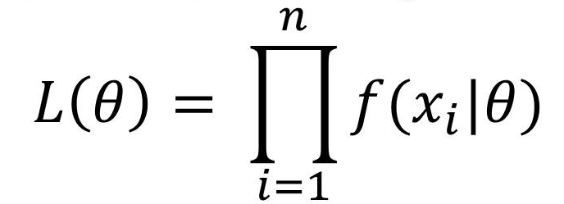
Maximum Likelihood Estimation
The maximum likelihood estimation procedure is used to estimate the weights in the CRF model.
Definition: Given a set of training data (X, Y), the maximum likelihood estimation procedure aims to find the weights that maximize the log-likelihood function, log p(Y|X,θ). The weights are then used to make predictions on unseen data.
Notes:
- the log-likelihood function is a measure of how well a model fits the observed data. The higher the value of the log-likelihood function, the better the model fits the data. The log-likelihood function is used in maximum likelihood estimation to determine the best-fitting model among a set of candidate models.
he log-likelihood is a commonly used evaluation metric in Conditional Random Fields (CRFs), which are a type of probabilistic graphical model used for sequence labeling problems, such as Part-of-Speech (POS) tagging, named entity recognition, and chunking.
In CRFs, the log-likelihood is used to evaluate the quality of the model by measuring how well it fits the training data. The log-likelihood of a CRF model is defined as the log of the probability of observing the training data given the model parameters. The goal of training a CRF model is to find the parameters that maximize the log-likelihood of the training data.
Mathematically, the log-likelihood of a CRF model can be expressed as:
LL = log(P(Y|X,θ))
where Y is the observed sequence of labels, X is the observed sequence of features, θ is the model parameters, and P(Y|X,θ) is the probability of observing the sequence of labels Y given the sequence of features X and the model parameters θ.
The log-likelihood is a useful evaluation metric because it provides a single scalar value that summarizes how well the model fits the training data. The higher the log-likelihood, the better the model fits the training data. The log-likelihood can also be used to compare different CRF models and to choose the best model based on its performance on the training data.
Gradient descent is an optimization algorithm used to minimize a cost function by updating the parameters of a model iteratively. It works by computing the gradient of the cost function with respect to the model parameters and taking a step in the direction of the negative gradient to reduce the value of the cost function. This process is repeated until the cost function reaches a minimum or a stopping criterion is met. The magnitude of the step taken in the negative gradient direction is determined by a learning rate, which controls the speed of convergence. Gradient descent is widely used in machine learning to train various models, including linear regression, logistic regression, and neural networks.

Slide 60
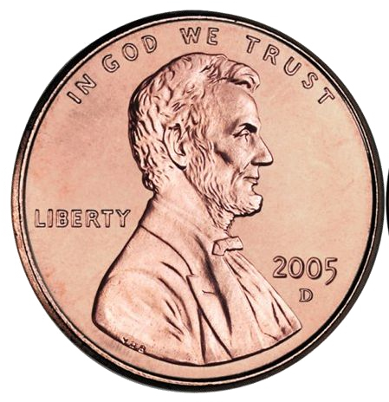
Suppose I show you a biased coin: with parameter θ where P(Head) = θ
I ﬂip the coin 100 times in front of you, ﬁnally we get 30 heads and 70 tails.

Slide 61
Suppose I show you a biased coin: with parameter θ where P(Head) = θ
I ﬂip the coin 100 times in front of you, ﬁnally we get 30 heads and 70 tails. Intuitively, what is an estimate for θ?

Slide 62
Suppose I show you a biased coin: with parameter θ where P(Head) = θ
I ﬂip the coin 100 times in front of you, ﬁnally we get 30 heads and 70 tails. Intuitively, what is an estimate for θ?
=> θ = 30 / 100 = 0.3

Slide 63
Suppose I show you a biased coin: with parameter θ where P(Head) = θ
I ﬂip the coin 100 times in front of you, ﬁnally we get 30 heads and 70 tails. Intuitively, what is an estimate for θ?
=> θ = 30 / 100 = 0.3
P(data; θ) = P(30 heads and 70 tails; θ) = P(30 heads; θ) x P(70 tails; θ)

Slide 64
Suppose I show you a biased coin: with parameter θ where P(Head) = θ
I ﬂip the coin 100 times in front of you, ﬁnally we get 30 heads and 70 tails. Intuitively, what is an estimate for θ?
=> θ = 30 / 100 = 0.3
P(data; θ) = P(30 heads and 70 tails; θ) = P(30 heads; θ) x P(70 tails; θ)
= θ³⁰(1 - θ)⁷⁰

Slide 65
Suppose I show you a biased coin: with parameter θ where P(Head) = θ
I ﬂip the coin 100 times in front of you, ﬁnally we get 30 heads and 70 tails. Intuitively, what is an estimate for θ?
=> θ = 30 / 100 = 0.3
P(data; θ) = P(30 heads and 70 tails; θ) = P(30 heads; θ) x P(70 tails; θ)
= θ³⁰(1 - θ)⁷⁰
Maximizing θ³⁰(1 - θ)⁷⁰ is equivalent to maximizing log(θ³⁰(1 - θ)⁷⁰) =

Slide 66
Suppose I show you a biased coin: with parameter θ where P(Head) = θ
I ﬂip the coin 100 times in front of you, ﬁnally we get 30 heads and 70 tails. Intuitively, what is an estimate for θ?
=> θ = 30 / 100 = 0.3
P(data; θ) = P(30 heads and 70 tails; θ) = P(30 heads; θ) x P(70 tails; θ)
= θ³⁰(1 - θ)⁷⁰
Maximizing θ³⁰(1 - θ)⁷⁰ is equivalent to maximizing log(θ³⁰(1 - θ)⁷⁰) = 30log(θ) + 70log(1-θ)

Slide 67
Suppose I show you a biased coin: with parameter θ where P(Head) = θ
I ﬂip the coin 100 times in front of you, ﬁnally we get 30 heads and 70 tails. Intuitively, what is an estimate for θ?
=> θ = 30 / 100 = 0.3
P(data; θ) = P(30 heads and 70 tails; θ) = P(30 heads; θ) x P(70 tails; θ)
= θ³⁰(1 - θ)⁷⁰
Maximizing θ³⁰(1 - θ)⁷⁰ is equivalent to maximizing log(θ³⁰(1 - θ)⁷⁰) = 30log(θ) + 70log(1-θ) Derivative => 30/θ - 70/(1-θ) => it hits zero when θ = 30/100

Slide 68
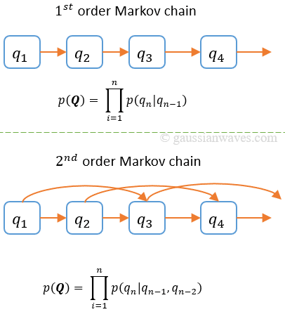
First-Order Markov Assumption vs Higher-Order Markov Assumption
First-Order Markov Assumption: The First-Order Markov Assumption states that the probability of a label at a given position in a sequence depends only on the label at the previous position in the sequence.
Higher-Order Markov Assumption: The Higher-Order Markov Assumption extends the First-Order Markov Assumption by allowing the probability of a label at a given position in a sequence to depend on the labels at several previous positions in the sequence.
Notes:
The First-Order Markov Assumption and the Higher-Order Markov Assumption are two different ways of modeling the dependencies between the elements in a sequence.

Slide 69
The Viterbi Algorithm

Slide 70
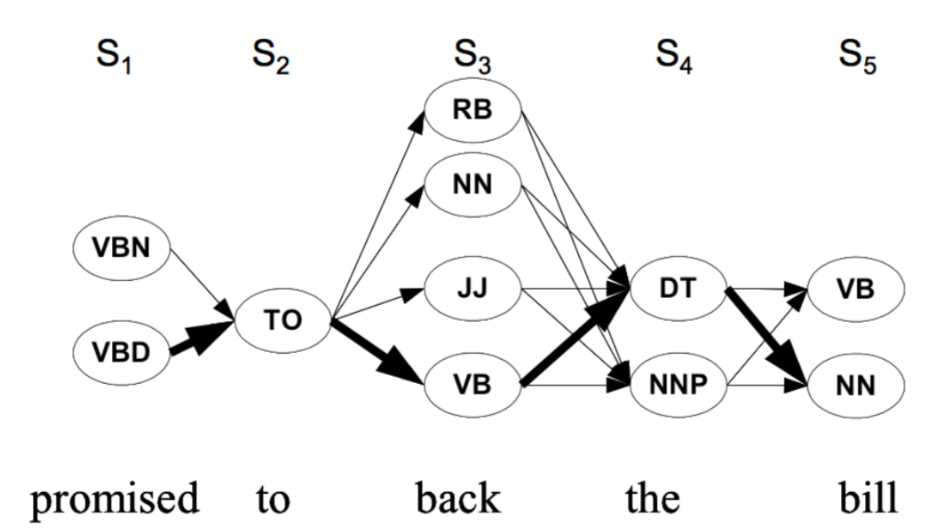
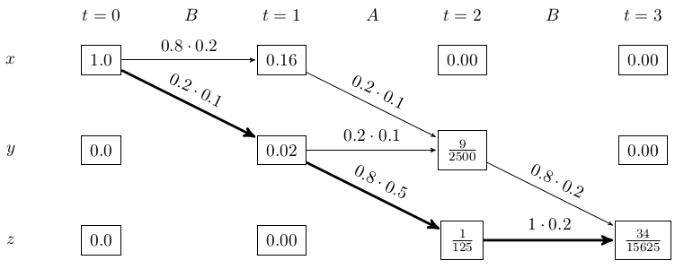
The Viterbi Algorithm
The Viterbi Algorithm is an efficient method for decoding the most probable sequence of labels given a sequence of observations.
Definition: Given a sequence X of observations and a CRF model, the Viterbi Algorithm calculates the most probable sequence of labels Y by finding the path through the state trellis with the highest conditional probability p(Y|X).
Notes:
A state trellis is a graphical representation of the possible states and transitions of a dynamic system over time.

Slide 71
Example

Slide 72
Conditional Random Fields In NER
PERS
OTHER
ORGA
OTHER
DATE
Jim
bought
Google
in
2021

Slide 73
Y₁
PERS
Y₂
OTHER
Y₃
ORGA
Y₄
Y₅
OTHER
DATE
Jim
bought
Google
in
2021
X₁
X₂
X₃
X₄
X₅

Slide 74
Y₁
PERS
Y₂
OTHER
Y₃
ORGA
Y₄
Y₅
OTHER
DATE
Jim
bought
Google
in
2021
X₁
X₂
X₃
X₄
X₅

Slide 75
Y₁
PERS
Y₂
OTHER
Y₃
ORGA
Y₄
Y₅
OTHER
DATE
Jim
bought
Google
in
2021
X₁
X₂
X₃
X₄
X₅

Slide 76
Y
Y
Y
Y₄ Ψ₁(Y₅, Y₄,
X )
Y₅
1
2
3
5
PERS
OTHER
ORGA
OTHER
DATE
Jim
bought
Google
in
2021
X₁
X₂
X₃
X₄
X₅
Ψ₁(Y₅, Y₄, X₅) = θ₁ if Y₅ = ‘DATE’ and Y₄ = ‘OTHER’ and X₅ is a number else 0.

Slide 77
Y
Y
Y
Y₄ Ψ₁(Y₅, Y₄,
X )
Y₅
1
2
3
5
PERS
OTHER
ORGA
OTHER
DATE
Jim
bought
Google
in
2021
X₁
X₂
X₃
X₄
X₅

Slide 78
Y
Y
Y
Y₄ Ψ₁(Y₅, Y₄,
X )
Y₅
1
2
3
5
PERS
OTHER
ORGA
OTHER
DATE
Ψ₂(Y₃, X₃)
Jim
bought
Google
in
2021
X₁
X₂
X₃
X₄
X₅
Ψ₂(Y₃, X₃) = θ₂ if Y₃ = ‘ORGA’ and X₃ starts with a capital letter, else 0.

Slide 79
Y
Y
Y
Y₄ Ψ₁(Y₅, Y₄,
X )
Y₅
1
2
3
5
PERS
OTHER
ORGA
OTHER
DATE
Ψ₂(Y₃, X₃)
Jim
bought
Google
in
2021
X₁
X₂
X₃
X₄
X₅

Slide 80
Y
Y
Y
Y₄ Ψ₁(Y₅, Y₄,
Y₅
1
2
3
X )
5
PERS
OTHER
ORGA
OTHER
DATE
Ψ₃(Y₁, X₁,X₂)
Ψ₂(Y₃, X₃)
Jim
bought
Google
in
2021
X₁
X₂
X₃
X₄
X₅
Ψ₃(Y₁, X₁, X₂) = θ₃ if Y₁ = ‘PERS’ and X₁ belongs to a dictionary of names and X₂ is a verb

Slide 81
Ψ₄ (Y_{t}, Y_{t-1})
Y
Y
Y
Y₄ Ψ₁(Y₅, Y₄,
Y₅
1
2
3
X )
5
PERS
OTHER
ORGA
OTHER
DATE
Ψ₃(Y₁, X₁,X₂)
Ψ₂(Y₃, X₃)
Jim
bought
Google
in
2021
X₁
X₂
X₃
X₄
X₅
Ψ₄(Y₃, Y₂) = θ₄ if Y₂ = ‘OTHER’ and Y₃ = ‘ORGA’

Slide 82
We are interested in modeling P(Y | X) and not P(Y,X) => CONDITIONAL
Y₁
PERS
Y₂
OTHER
Y₃
ORGA
Y₄
Y₅
OTHER
DATE
Jim
bought
Google
in
2021
X₁
X₂
X₃
X₄
X₅
Ψ₄(Y₃, Y₂) = θ₄ if Y₂ = ‘OTHER’ and Y₃ = ‘ORGA’

Slide 83
Conditional Random Fields
Take away points:
Factor models are a pattern recognition machine learning model for structured prediction
CRF’s model P(Y | X) where X is always observable and does not care about
P(X) or P(X | Y) => A discriminative model, can use complex features X and more efficient, BUT always needs complete features X => does not handle incomplete data very well
We use linear chain CRF’s (Every Y_{t} depends only on Y_{t-1} and Y_{t+1} ) for sequential tasks such as NER, Speech to text, ...

Slide 84
Y₁
ORG
Y₂
O
Y₃
PERS
Y₄
O
Y₅
O
Y₆
LOC
BOS
U.N.
official
Ekeus
heads
for
Baghdad
X₁
X₂
X₃
X₄
X₅
X₆

